Slide 1

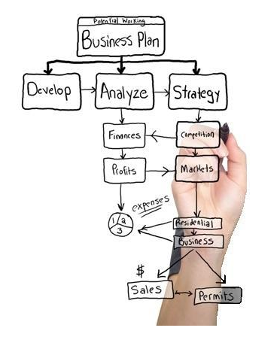





Slide 2
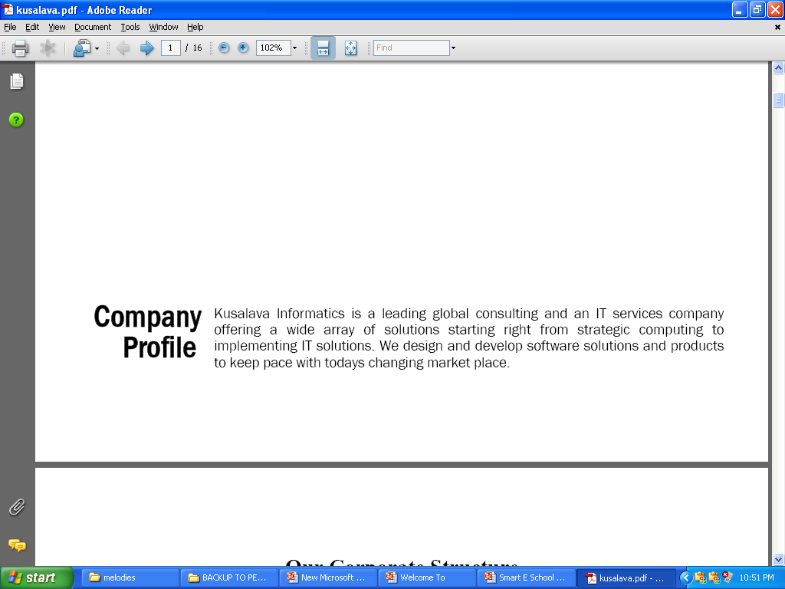








Kusalava Group
Started in 1964 has a turnover of about 25 million dollars with the following other group companies.
Kusalava International Ltd
Kusalava Finance Ltd
Kraus Inc
GROUP
Companies
Kusalava Batteries (P) Ltd
Kusalava Realty
Kusalava Motors (P) Ltd
Bharat Automobiles
Kusalava Technologies

Slide 3




OUR PRODUCTS
smart enterprise
Simplifying Business Management
For Schools
For Engineering Colleges
For Intermediate College Groups
With an Integrated Swipe Solution
For Manufacturing Industries
For NFBC Finance Companies
For Trading Companies
For Automotive Dealerships
HRM for any Industry

Slide 4








CLIENTELE
smart – e – school Usage Analysis
No. of Clients | 7
No. of Campuses | 86
No. of Active Users | 1500
No. of Affiliations | 6
No. of Course Types | 12
No. of Students | 90,000
S.Norr | Group / Client Name | S.No | Campus Name | Institution Type / Affiliation
1 | BIS | 1 (1) | BIS | School
2 | MVR | 2 (1) | MVR | Engineering College (JNTU Affiliation)
3 | NRI EDUCATIONAL SOCIETY | 3 (1) (78) | NRI ACADEMY (49 Campuses) | Junior College
4 | INDIAN SPRINGS | 4 (1) (3) | INDIAN SPRINGS (3 Campuses) | School
5 | CHALAPATHI | 5 (1) | CIET (LAM) | Engineering College (ANU Affiliation)
6 | SVKP | 6 (1) | SVKP DEGREE COLLEGE | Degree College (Aided ANU Affiliation)
 |  | 6(2) | SVKP INTER COLLEGE | Junior College (Aided)
7 | VR SIDDHARTHA ENGINEERING COLLEGE | 7(1) | VR SIDDHARTHA ENGINEERING COLLEGE | Engineering College ( AUTONOMOUS)
8 | KVSR PHARMACY COLELGE | 8(1) | KVSR PHARMACY COLLEGE | Pharmacy College(KRISHNA Affiliation)

Slide 5


smart enterprise
Simplifying Business Management
CLIENTELE
S.No | Group / Client Name | Units | Business Type | Locations
1 | KUSALAVA INTERNATIONAL LIMITED | 4 | Cylinder Liners Manufacturer | Adavinekkalam,, Rudrapur ,Vizag, Vijayawada
2 | KUSALAVA ALCAST LIMITED | 1 | Pistons Manufacturer | Surampalli, AP
3 | BHARAT AUTOMOBILES LTD | 4 | Automobiles Trading Concerns | Vijayawada, Hyderabad and Chennai
4 | KUSALAVA FINANACE LTD | 1 | Auto Finance Concern | Vijayawada
5 | KUSALAVA MOTORS PVT LIMITED (FOUR WHEELER) | 3 | AUTO Show Room Concern | Vijayawada, Guntur and Bhimavaram
6 | KUSALAVA MOTORS PVT LIMITED (TWO WHEELER) | 2 | AUTO Show Room Concern | Vijayawada and Gudivada
7 | CHUKKAPALLI CHARITABLE TRUST | 1 | Non Profitable Concern | Vijayawada
8 | SNEHA BIOTECH PVT LTD | 1 | Bio Tech medicines | Vijayawada
9 | Sri Chakra Automobiles | 1 | AUTO Show Room Concern | Ongole
10 | Kusalava Batteries Pvt Ltd | 3 | Batteries Trading Concern | Vijayawada, Chennai and Ahmedabad
smart – e – school Usage Analysis
No. of Clients | 10
No. of Units | 21
No. of Active Users | 170

Slide 6
“Auto Finance Requirements needs no more manual calculations.”
Why use a Auto Finance Software in an Organization
“Caters to multiple organization companies.”
“Extremely User Friendly Interface.”
“All Auto Finance related financial entries are automatically posted to Smart e Auto Finance Software.”
“Broadly divided into Hire Purchase and Debentures. Bothe are integrated with Account module.”
“Track complete details of Hirer and Guarantor. A hirer can link to as a Guarantor to a Hire purchase agreement.”
“Manage Installment Receipts effectively with extensive analysis.”
“Automatic Penal interest calculation based on given inputs to hire purchase agreement.”
“Email and SMS were integrated in the application.”
“Functionality include are write off approval for the penal interest, Travelling Expenses, Agent vs. Targets and accounting reports.”
“Developed using Dot. Net. No need for client installations. Single server installation is sufficient.”
“Modular Approach makes it easier to add modules later .”
“ Multi User Management system with permissions at various levels.”

Slide 7
“Auto Finance Requirements needs no more manual calculations.”
Pain Areas of small and medium enterprises
“Hirer complete Details along with their Guarantor s Details. A hirer can be Guarantor or Guarantor can be a hirer.”
“Effective tracking of day to day transaction like installment receipts and disbursement of Funds.”
“Effective Analysis of due list with various parameters like agent wise, segment wise and agreement wise .”
“Integration of Hire purchase with Account. All monetary effects should be integrated with the account module.”
“Effectively track Penalty amount on the belated installment amount received.”

Slide 8


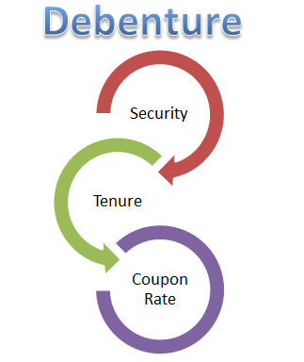


“Tedious jobs like hire purchase transactions, payroll generation, leaves management and reports are done with a single mouse click.”
Proposed solution for Auto Finance Management
AUTO
FINANCE
Hire Purchase
Debentures
Product Base
HRM
Accounts
“ The Complete cycle of Auto Finance starting from Hire Purchase to Account management can be maintained in a efficient and promising way to have timely decision making.”

Slide 9

“Module: Auto Finance”
Hypothecations

Slide 10
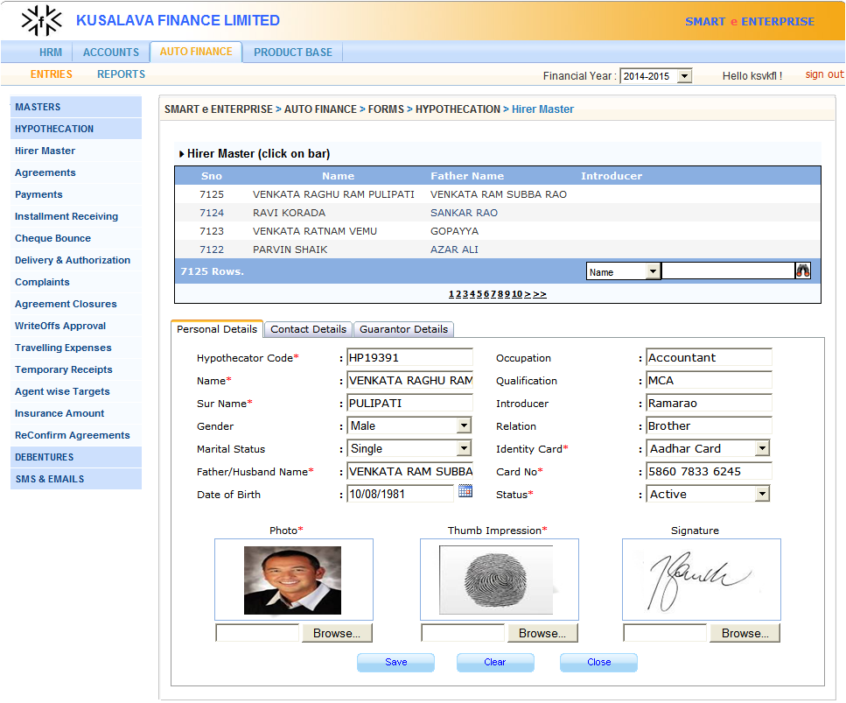
“Module: Auto Finance.”
“Detailed functionality of Hypothecations”
MASTERS
Insurance Companies
Insurance Cover Notes
Hypothecation Interests
Agents
Segments
Vehicles
Vehicle Market Value
Dealers
Dealer vs. Incentives
Other Pay Components
Status wise Discounts
HYPOTHECATION
Hirer Master
Agreements
Payments
Installment Receiving
Cheque Bounce
Delivery & Authorization
Complaints
Agreement Closures
Write Off s Approvals
Travelling Expenses
Temporary Receipts
Agent wise Targets
Insurance Amount
Reconfirm Agreements

Slide 11

“Module: Auto Finance.”
Debentures

Slide 12
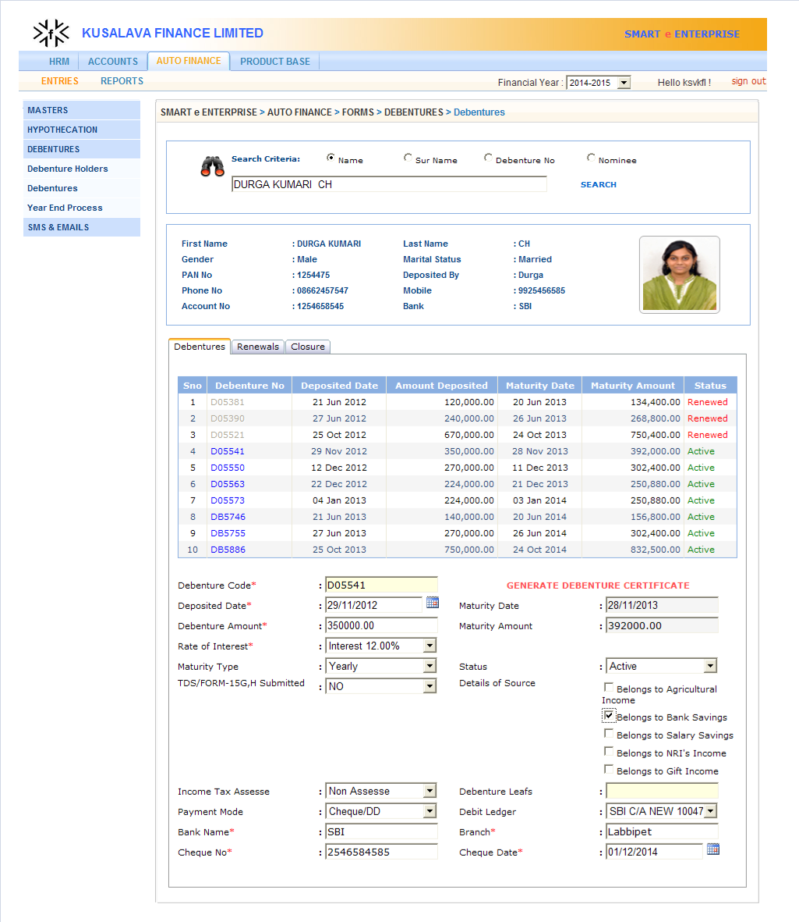
“Module: Auto Finance.”
“Detailed functionality of Debentures”
MASTERS
Debenture Interests
Debenture Leafs
Premature With drawls
Debentures
Debenture Holders
Debentures
Year End Process
SMS & EMAILS
SMS
Emails

Slide 13

“Module: Accounts.”
Vouchers
BRS
Assets
TDS
Accounts

Slide 14
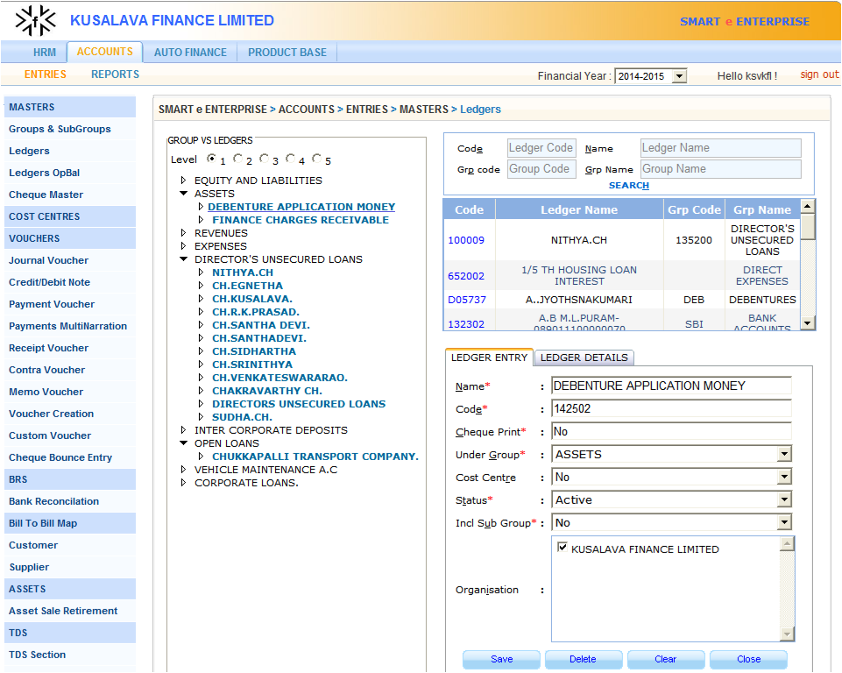
“Module: Accounts .”
“Detailed functionality of Accounts .”
MASTERS
Groups & Subgroups
Ledgers
Ledger Opening Balance
Cheque Master
VOUCHERS
Journal Voucher
Credit/Debit Note
Payment Voucher
Receipt Voucher
Contra Voucher
Memo Voucher
Voucher Creation
Custom Voucher
Cheque Bounce Entry
BRS
Bank Reconciliation
BILL TO BILL MAP
Customer
Supplier
ASSETS
Asset Sale Retirement
TDS
TDS Section
TDS Component
TDS Component Structure
TDS Section Details

Slide 15

“Module: Product Base.”
Product Base

Slide 16
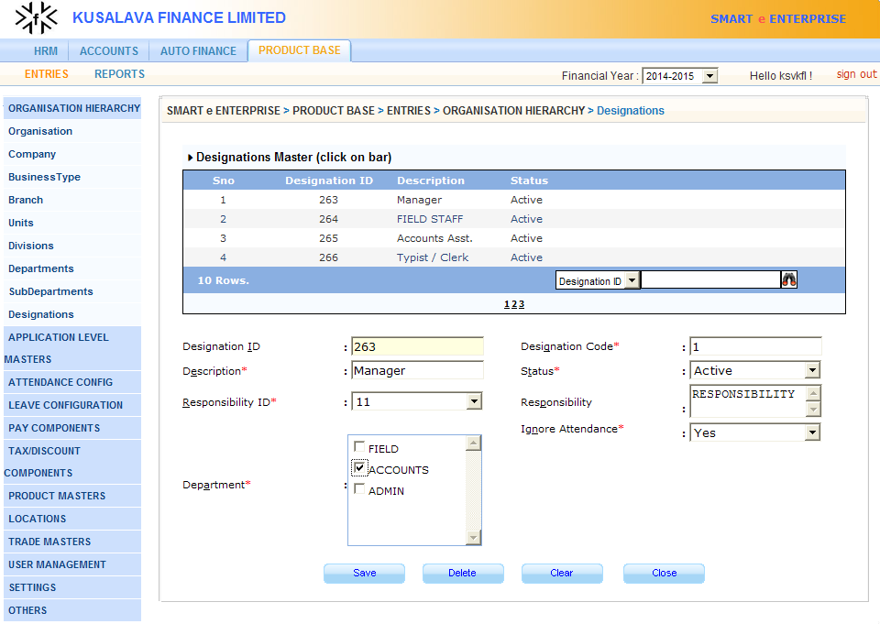
“Module: Product Base.”
“Detailed functionality of Product Base.”
ORGANISATION HIERARCHY
Organisation
Company
Business Type
Branch
Units
Divisions
Departments
SubDepartments
Designations
APPLICATION LEVEL MASTERS
Financial Year
Currency
Currency Conversion
Language Master
Countries
States
ATTENDANCE CONFIG
Shift
Default Weekly offs
Weekly offs Exceptions
Holiday Settings
Attendance Rules
Category Confirmation
LEAVE CONFIGURATION
Leave Master
Leave Details
Leave Structures
Holiday/Weekend
Encashment & Carry Fwd
Prorating Options
Leave Rules

Slide 17
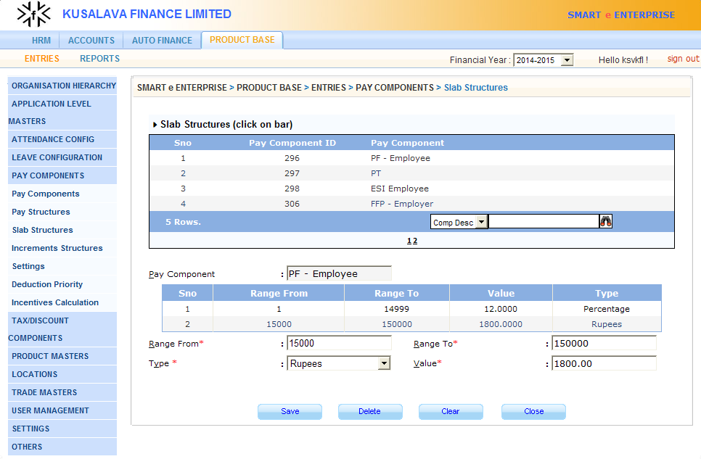
“Module: Product Base.”
“Detailed functionality of Product Base.”
PAY COMPONENTS
Pay Components
Pay Structures
Slab Structures
Increments Structure
Settings
Deduction Priority
Incentives Calculation
TAX/DISCOUNT COMPONENTS
Tax Master
LOCATIONS
Location
Ware House
TRADE MASTER
Sales Executive
Transporter
USER MANAGEMENT
Modules
Forms
Roles
Role vs. Forms
Users
SETTINGS
Branch Settings
Type Definer
Dynamic Columns
Block Periods
Masks
OTHERS
Contractors
Responsibilities
HRIS Settings
Policy

Slide 18

“Module: Human Resource Information System (HRIS).”
Name:
Experience:
Qualification:
Address:
DOB:
Identification Marks:
Human Resource
Management

Slide 19
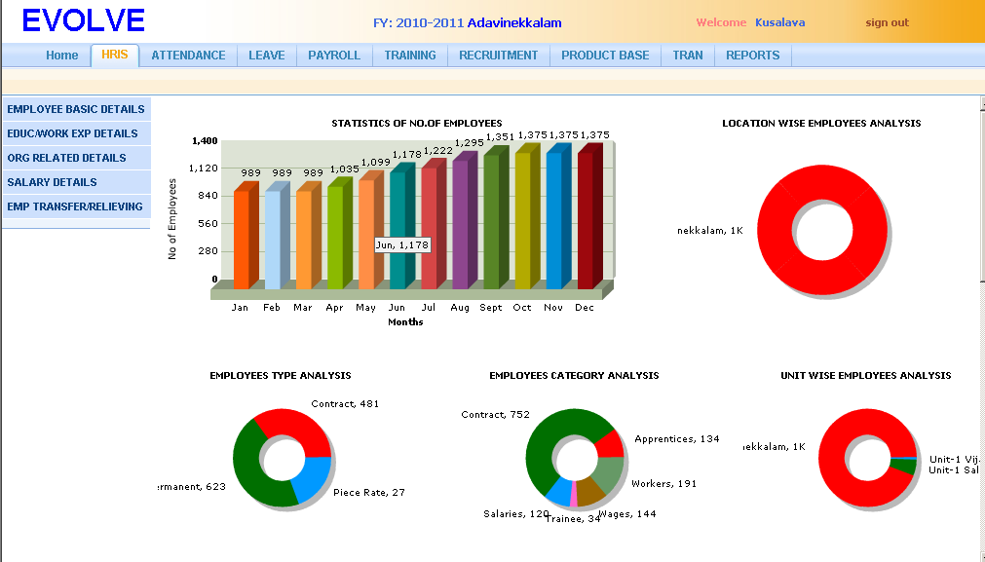

“Module: HRIS.”
“Quick Insight of HRIS.”
Graphical Representation (DASH BOARD) showing statistics of HRIS

Slide 20

“Module: User Management.”
Accounts Manager
Marketing Executive
HR Employee
Director
User
Management

Slide 21
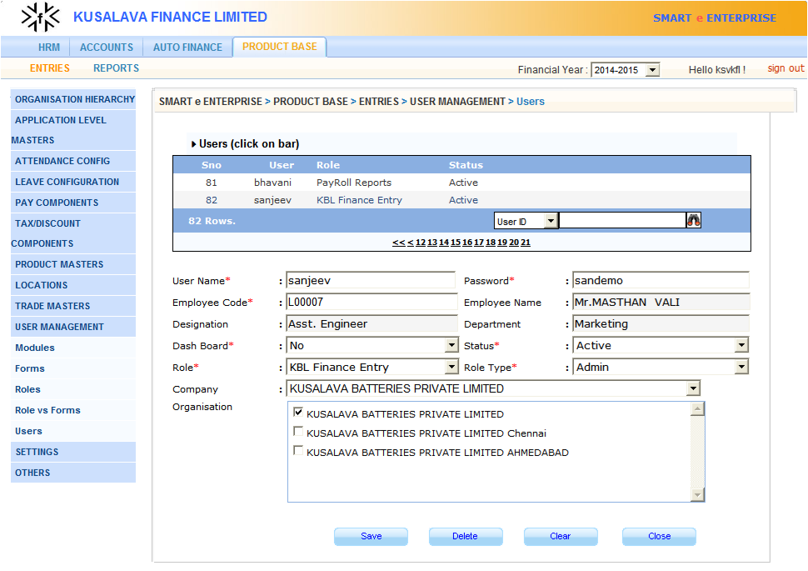
“Module: User Management.”
“Detailed functionality of User Management.”
USER MANAGEMENT
Modules
Forms
Roles
Role Permissions
Users

Slide 22

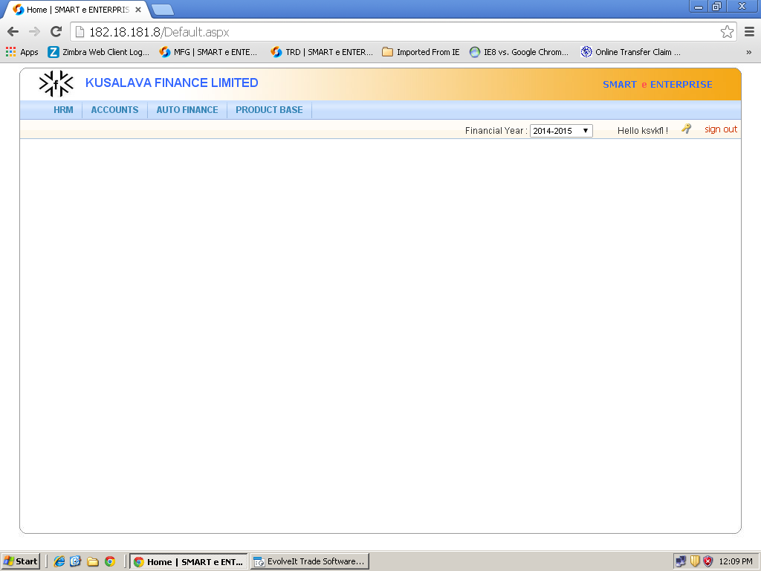

“Quick Insight of smart e Auto Finance.”

Slide 23

“Feature: Drill Down Analysis.”
Drill Down
Analysis

Slide 24
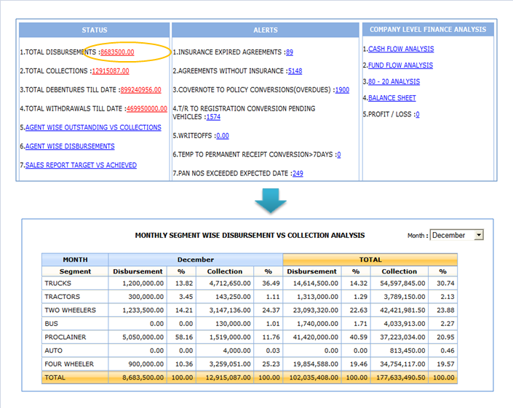
“Feature: Drill Down Analysis.”
“Detailed functionality of Drill Down Analysis.”
LEVEL 1
Note
Clicking on LINK at each LEVEL will navigate to NEXT LEVEL of DRILL DOWN REPORTS as shown in slide
LEVEL 2

Slide 25
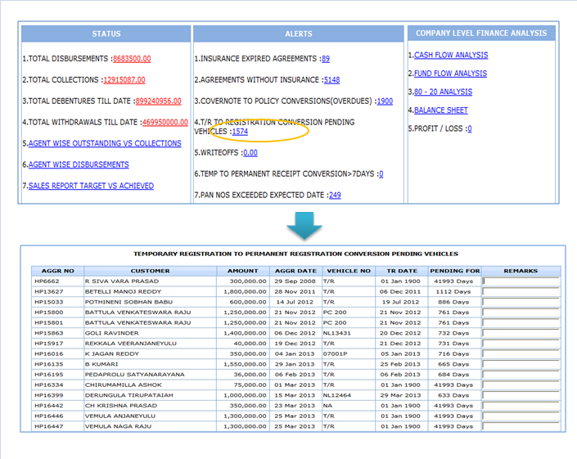
“Feature: Drill Down Analysis.”
“Detailed functionality of Drill Down Analysis.”
LEVEL 1
Note
Clicking on LINK at each LEVEL will navigate to NEXT LEVEL of DRILL DOWN REPORTS as shown in slide
LEVEL 2

Slide 26


“Feature: Reports.”
Reports

Slide 27
“Feature: Reports.”
“Quick Insight of Reports.”
List of Reports
* MASTERS
Hirers Mater
Interest Master
Agent Master
* DISBURSE AND COLLECTIONS
OR1 Seg wise Consol'dt
OR4 Agent & Seg wise O/s
OR5 Seg wise Disbursed
OR6 Disbursed & Receipts
Collections Comparision Statement
Monthly Avg Collections
Installments Status
T/R-Permanent Receipts
Multiple Agr Payments
HP Collective Payments
Cash & Bank Book
Disburse Comparision
* AGREEMENTS
Agreement Details
Status wise Agreements
Registration Pendings
Fin.Charges Realisation
Insurance Realisation
Finance Charges Viewer
* AGENTWISE
OR3 Agent wise Consolidate
Agent wise Collections
Target vs. Achieved
Travelling Expenses
Receipts & Payments
Below are few of REPORTS
Generated in Application
Only reports in the hypothecations and debentures modules have been listed

Slide 28
“Feature: Reports.”
“Quick Insight of Reports.”
List of Reports
* DUES LIST
Consolidate Dues List
Dues List with Ageing
Status wise Dues List
Due > Market Value
* DEBENTURES
Debenture Holders
Debenture Leafs
Debenture Holder Detailed
Individual Debentures
Debentures Abstract
Debenture Renewals
Pending PAN cards
* INSURANCE DETAILS
Insurance Dues
Cover Note Register
* OTHERS
Pre- Defined Templates
Installments Dues Notice
Label Printing
Below are few of REPORTS
Generated in Application
Only reports in the hypothecations and debentures modules have been listed

Slide 29
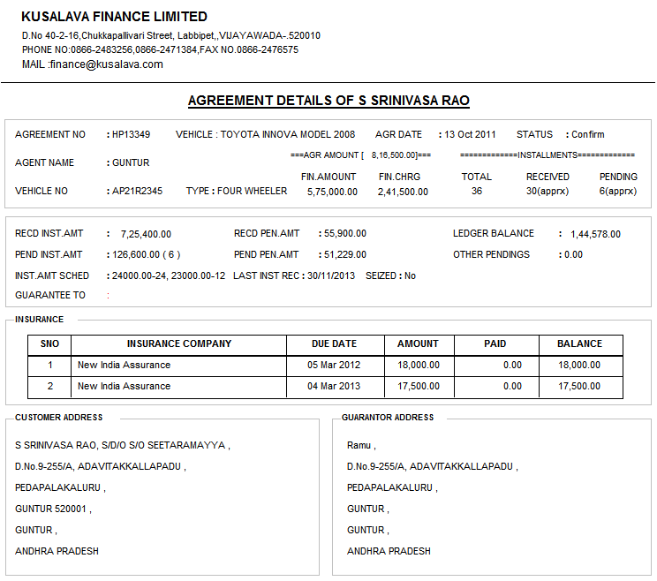
“Feature: Reports.”
“Detailed functionality of Reports.”
AGREEMENT DETAILS

Slide 30
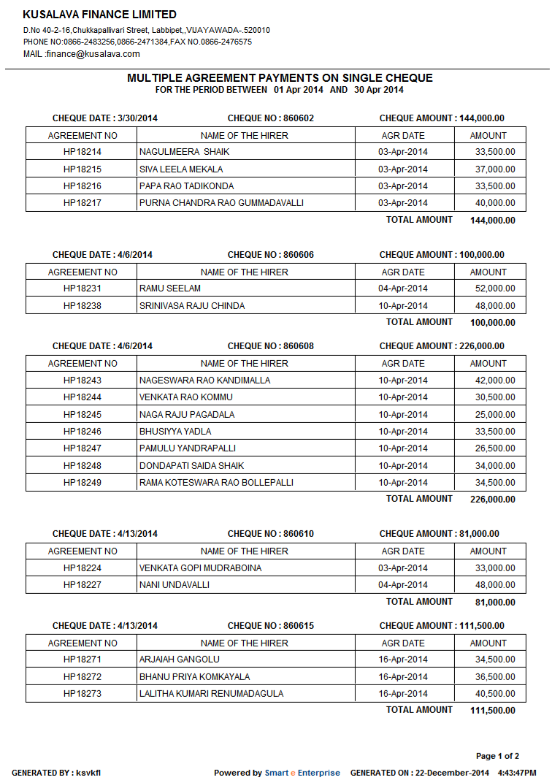
“Feature: Reports.”
“Detailed functionality of Reports.”
MULTIPLE AGREEMENT
PAYMENTS

Slide 31
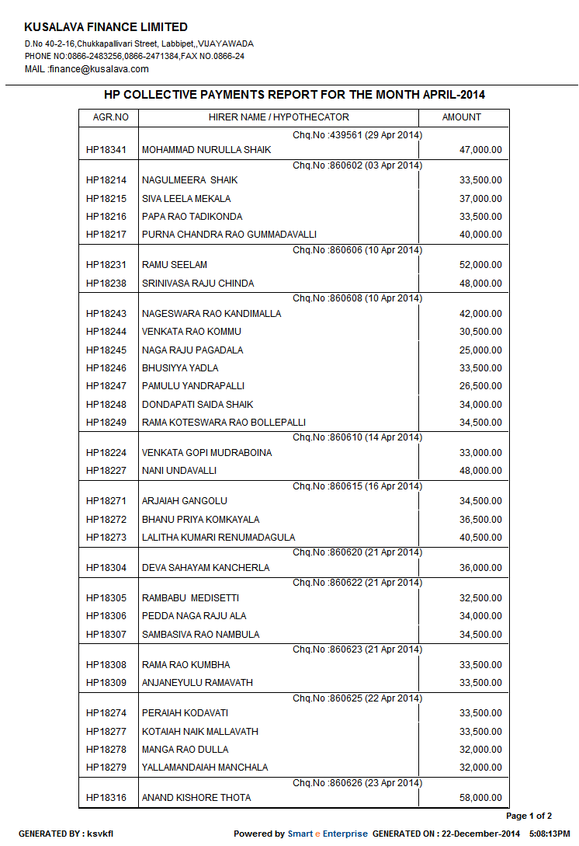
“Feature: Reports.”
“Detailed functionality of Reports.”
HP COLLECTIVE
PAYMENTS

Slide 32
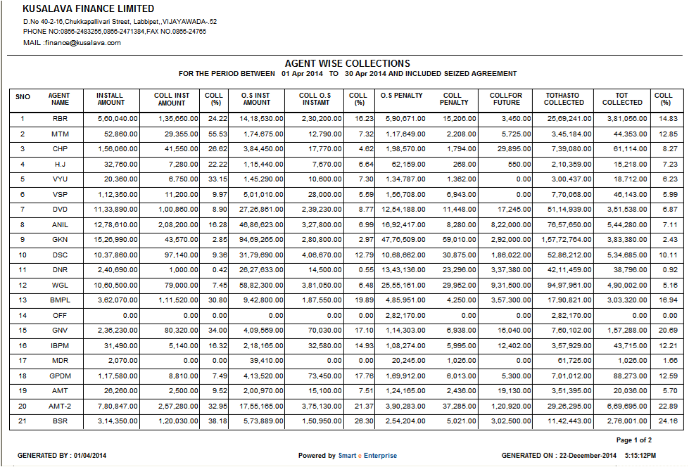
“Feature: Reports.”
“Detailed functionality of Reports.”
AGENT WISE COLLECTIONS

Slide 33

Questions…
Than Q…

